Slide 1
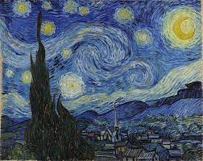


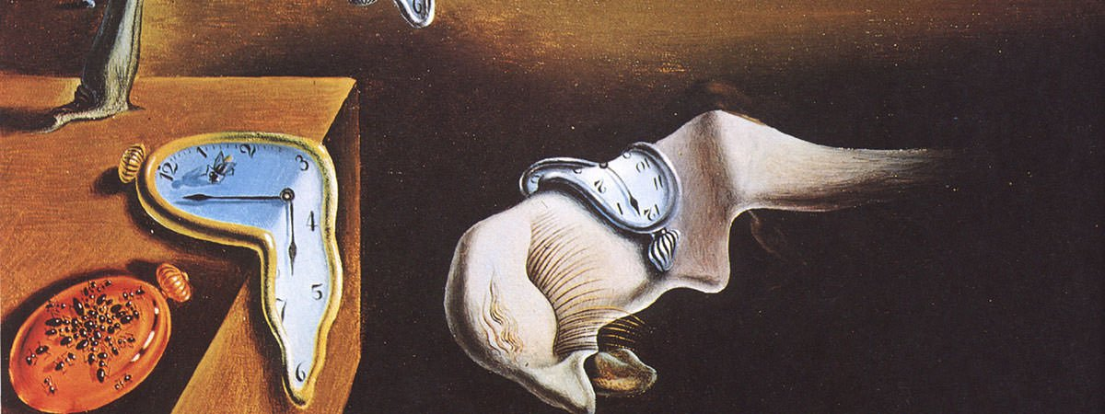

muse
Excited?
Confusion?
Buy?
MUSE
Making art accessible
Opportunity Framework
Alana Mittleman, Chirag Huria, Elias El Kozah, Rohan Paliwal
Scan.
Decide.
Digital Service Innovation (Spring 2022)
Carnegie Mellon University

Slide 2
Muse - Opportunity Framing
The empty slice means the frame is open-ended. We will be doing more customer research and reframing is always possible.
Artist Portfolios
Art
Galleries
Art/Artist Authenticity
Local
Artists
EXPLORE ASSESS
DECIDE
Home Decor
Painting Dimensions
Sell Art
Cost
Buy Art

Slide 3
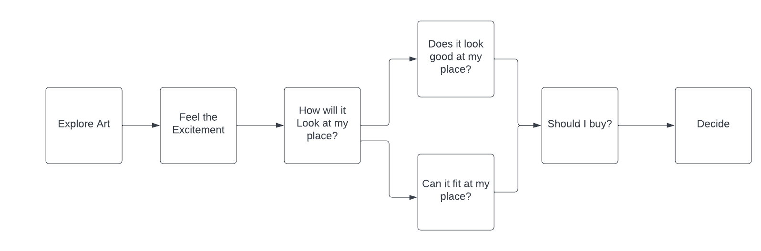
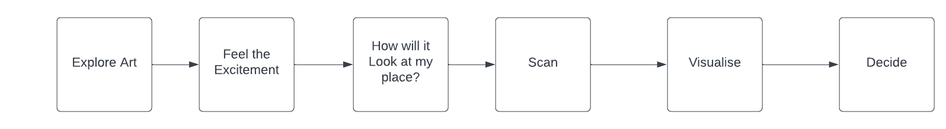
Without Muse
With Muse

